Slide 1
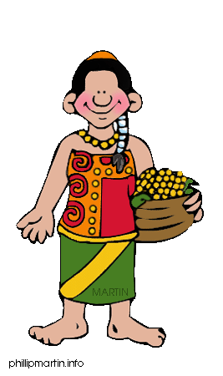
Mayan Society
Taylor/Domerese

Slide 2
Content Area: Social Studies
Grade Level: 7
Goal: I can describe the diverse characteristics of early civilization in the Americas by comparing and contrasting American Indian civilizations and societies such as the Maya, Aztec, and Inca.
Success Criteria: Given information about life in the Aztec culture, students will answer questions with 80% accuracy.
W4.3.2—State proposed standards

Slide 3
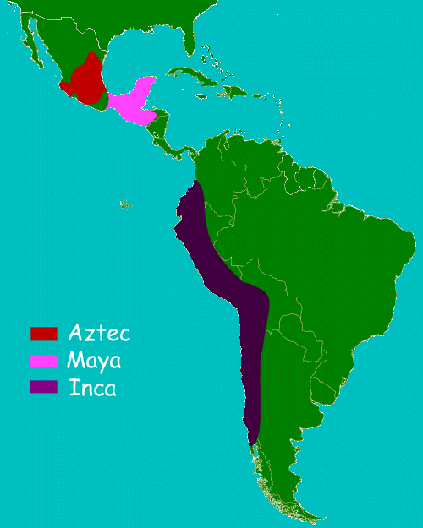
Mayan Location

Slide 4
Mayan Children
Encouraged to be independent, self-confident and to develop the ability to make decisions.
Most important quality for children to have was common sense.
Learned skills by shadowing their parents
GIRLS: were expected to do household duties such as cleaning, sewing, washing, look after the children and animals.
BOYS: Help their fathers. When boys reached four or five the dad would start training the boys to help with farming crops and also to hunt.
When the children were 15 they were expected to be independent.
Children only went to an actual school if they came from a important, wealthy family.
Children played tlachtli, a ball game for teams similar to a combination of basketball and soccer like the Aztecs did.

Slide 5
Mayan Social Classes
The social structure in the Maya Empire was set, which makes it a Caste System.
It was very difficult to move upwards.
Status was usually hereditary. Occupations for Maya men was limited to their father's occupation (Ex. If your father was a farmer, you were a farmer). Maya women could not marry outside their social class.
Mayan Social Structure:
High Caste: Rulers, Nobles, and Priests
Middle Caste: Businessmen, Merchants, Soldiers
Low Caste: Famers, Slaves

Slide 6
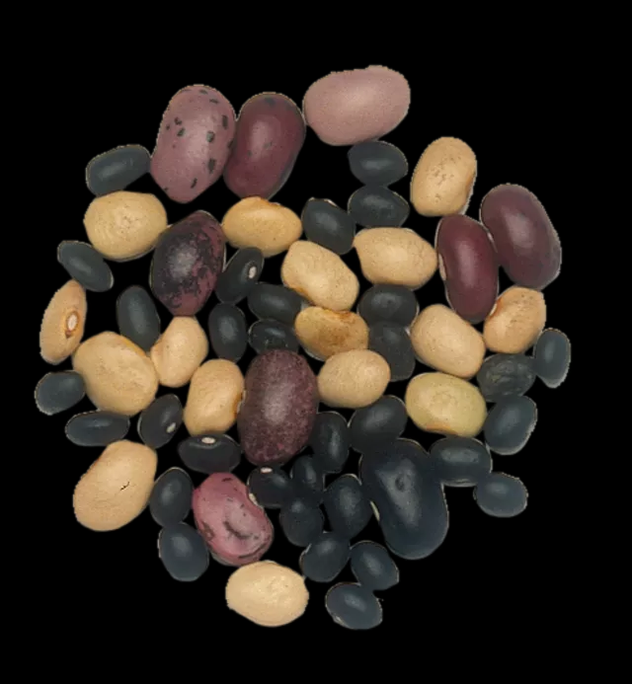
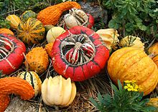
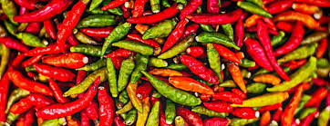
Mayan Foods
Hunted wild turkey, deer, ducks, and even monkey.
Fish
Eggs
Maize (corn) was most important—to make tortillas and bread.
Beans
Squash
Sweet Potatoes
Chilies

Slide 7
Mayan Women
Participated in government, politics, economics, and farming.
Helped ready their men for battle.
In charge of cooking the daily meals, which usually were composed of maize (corn), beans, and squash.
Farmers wives made their own clothes by weaving and spinning.
Were restricted to their social level (Caste System).
Could not inherit from their parents.
When a daughter married, she had to leave home immediately and live with her husband's parents until her first child was born.
Women could get a divorce and return home if her father would allow her to do so.
Marriages were arranged, and a new husband would be found for her, like it or not.

Slide 8
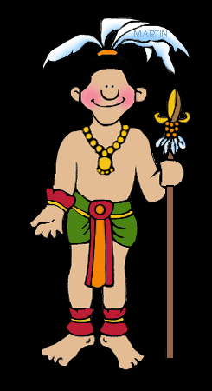
Mayan War
Warriors spent their life training to be better warriors.
Cities were often at war with each other.
Did not use metal weapons, but stone and wood weapons.
Fought battles only during the day. Temporary peace was called each night.
Battles went until the leader of one army was hurt or killed. Once that happened, the battle was over.
Losers had to pay a tribute to the winners--including goods, people, textiles, gold, silver, copper, and salt.

Slide 9
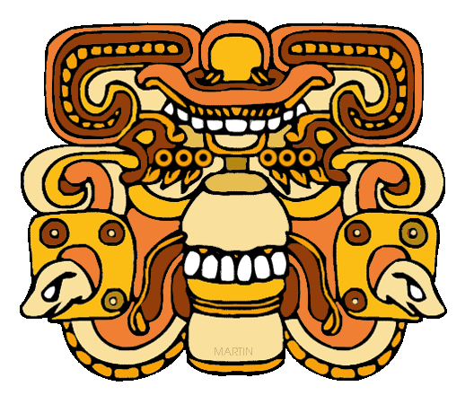
Mayan Religion
They were polytheistic, believed in many gods.
Religion was at the heart of everything they did.
Believed in a heaven, an earth, and an underworld:
Heaven-the home of the gods.
Earth-was for the living.
Underworld- place where demons lived.
Held many religious ceremonies to make sure the demons and other evil creatures who lived in the underworld stayed in the underworld.

Slide 10
Mayan Inventions/Creations
Ball Courts
Calendar System (Mayan Calendar)
Their own writing system
Rubber
Road systems

Slide 11
Test your knowledge
Most important quality for children to have was common sense.
True
False
The children that went to school were from important and wealthy families.
True
False

Slide 12
Test your knowledge
In a caste system, you can marry who you want and have any job you wish.
True
False
Which of these foods did the Mayans not eat, according to your notes?
Chilies
Beans
Squash
Hamburgers

Slide 13
Test your knowledge
Mayan women could divorce only if:
They paid a tax
Their husband allowed it
Their father allowed it
They promised not to marry again
Mayan Cities were usually at war.
True
False
In Mayan religion, the underworld was:
Where demons lived.
Areas south of the Mayans
A place where Mayans worshiped
Where Mayans farmed

Slide 14
You Are Correct!

Slide 15
You Are Correct!

Slide 16
You Are Correct!

Slide 17
You Are Correct!

Slide 18
You Are Correct!

Slide 19
You Are Correct!

Slide 20
You Are Correct!

Slide 21
Haha! You are Funny, Try Again!

Slide 22
You are Finished!

